Slide 1

TOTAL TECHNOLOGY
REPORTLAB COMPLETE TUTORIAL
PARAGRAPH inline font related MRKUP
Part 21

Slide 2
How to find what are the fonts available
from reportlab.pdfgen import canvas
from reportlab.platypus import Paragraph,SimpleDocTemplate
from reportlab.lib.units import cm
from reportlab.lib.styles import getSampleStyleSheet
pdf=canvas.Canvas("test.pdf")
fonts=pdf.getAvailableFonts()
for font in fonts:
print(font)
TOTAL TECHNOLOGY

Slide 3
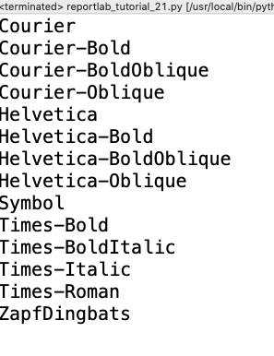
what are the fonts available
TOTAL TECHNOLOGY

Slide 4
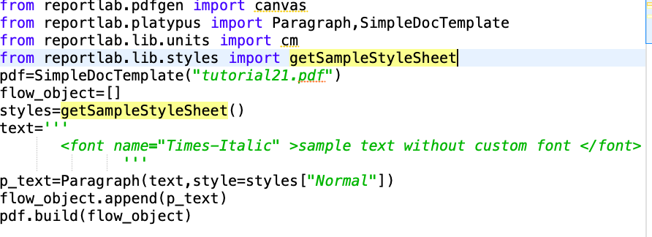
How to create paragraph text with differet font
TOTAL TECHNOLOGY

Slide 5
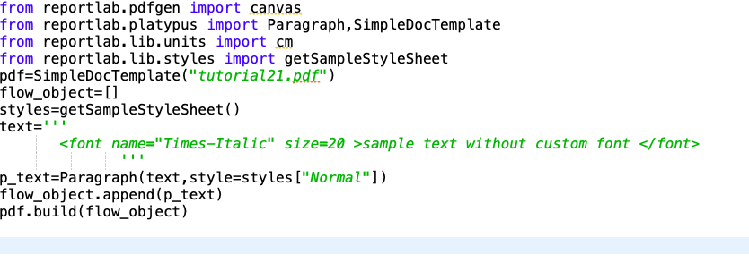
How to create paragraph text with differet font & size
TOTAL TECHNOLOGY

Slide 6
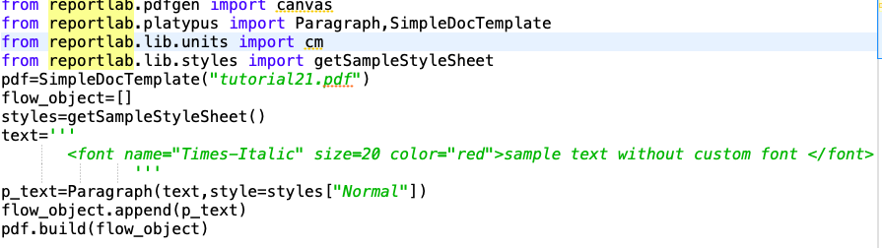
How to create paragraph text with differet font & size,color
TOTAL TECHNOLOGY

